Slide 1
AWS CLOUDFORMATION
// KLICK HEALTH
A WORKSHOP ON AWS CLOUDFORMATION
PRESENTED BY:
PATRICIA MACPHERSON

Slide 2
Managing complex Cloud Architectures

Slide 3



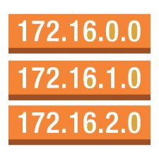







Cloud Architecture Components
security group
VPC subnet
IAM, Roles and Policies
EC2 Instances
Amazon VPC
Route Table
Internet gateway
VPN connection
Elastic Load
Balancing
Amazon S3
Amazon EBS
KMS Data Encryption
VPC peering
AWS OpsWorks
stack
layers
instances
apps

Slide 4
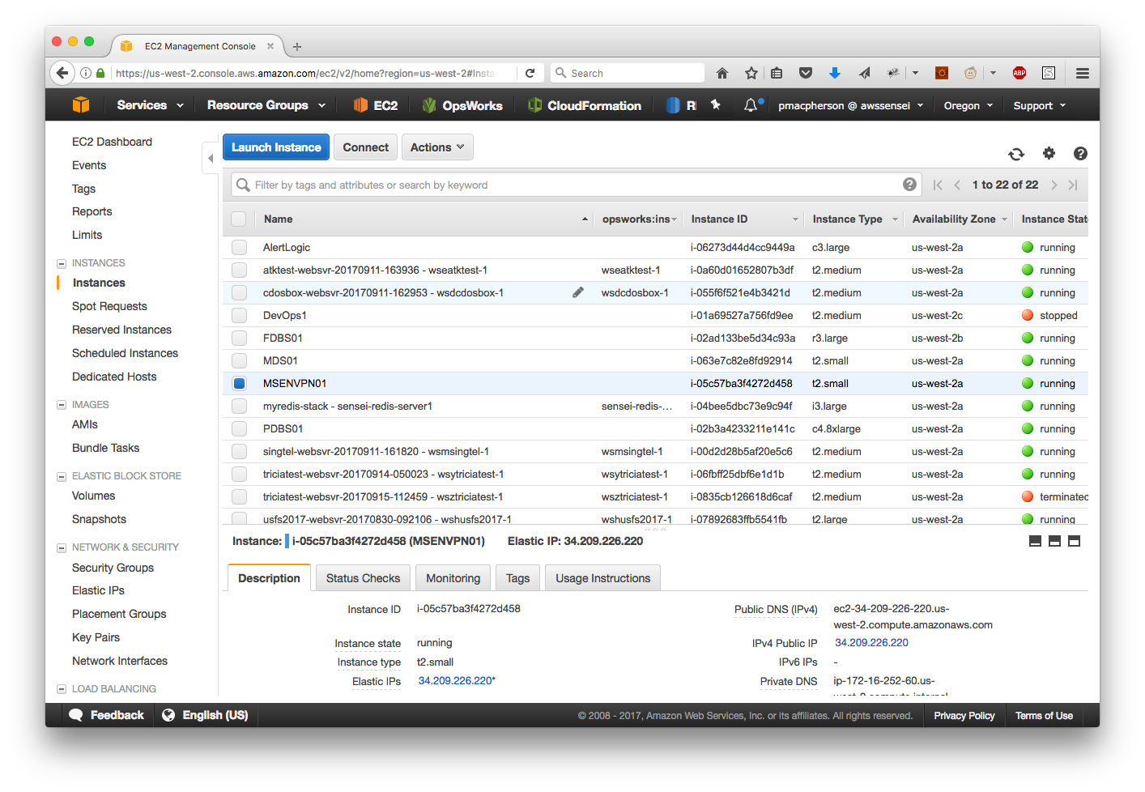
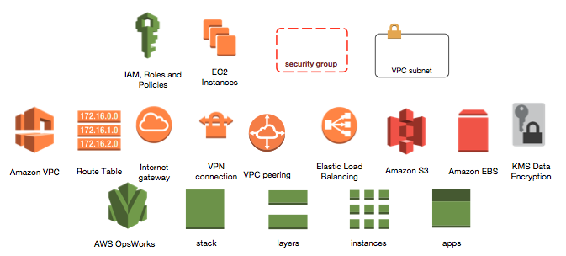
Manage via Console?
Time Consuming
Not (easily) auditable
Error Prone
Not repeatable

Slide 5
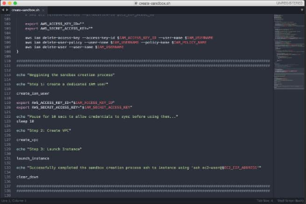
Manage via Scripts?
What happens if an API call fails?
How can I update my environment?
How do I roll back?

Slide 6
AWS Application Management Services

Slide 7


AWS Application Management Services
Elastic beanstalk
AWS OPSWORKS
AWS cloudformation
CONVENIENCE
CONTROL

Slide 8
Why use Cloudformation?
Define & manage your infrastructure as code
Benefits
Declarative approach with managed infrastructure dependencies
Self documenting
Intelligent updating of resources and automated rollback capabilities
AWS API interactions taken care for you
Reproducibility
Versioning

Slide 9
Cloudformation Template Anatomy
Demo: https://github.com/pmacpherson/cloudformation_workshop

Slide 10
Template Structure
AWSTemplateFormatVersion: "2010-09-09"
Description: A sample template
Parameters:
set of parameters
Mappings:
set of mappings
Conditions:
set of conditions
Resources:
set of resources
Outputs:
set of outputs

Slide 11
Resources
AWSTemplateFormatVersion: '2010-09-09'
Description: "Create an EC2 instance"
Resources:
myEC2Instance:
Type: AWS::EC2::Instance
Properties:
KeyName: "my-key-pair"
ImageId: "ami-75g0061f"
InstanceType: m3.medium
Name of Resource within this script.

Slide 12
Parameters
AWSTemplateFormatVersion: '2010-09-09'
Description: "Create an EC2 instance"
Parameters:
pInstanceType:
Description: "The EC2 instance type to launch"
Type: String
AllowedValues:
- "m1.micro"
- "m1.small"
- "m1.medium"
Resources:
myEC2Instance:
Type: AWS::EC2::Instance
Properties:
KeyName: "my-key-pair"
ImageId: "ami-75g0061f"
InstanceType: !Ref pInstanceType
Name of Parameter within this script.
Use parameters instead of hard-coded values inside scripts

Slide 13
Parameter Types
AWSTemplateFormatVersion: '2010-09-09'
Description: "Create an EC2 instance"
Parameters:
pVpcId:
Description: "Choose VPC"
Type: AWS::EC2::VPC::Id
pSubnetIds:
Description: "Choose Subnets"
Type: AWS::EC2::Subnet::Id
pSecurityGroups:
Description: "Choose Security Groups"
Type: List<AWS::EC2::SecurityGroup::Id>
pKeyPair:
Description: "Choose Key Pair"
Type: AWS::EC2::KeyPair::KeyName
Resources:
myEC2Instance:
Type: AWS::EC2::Instance
Properties:
KeyName: !Ref pKeyPair
ImageId: "ami-75g0061f"
InstanceType: "t2.micro"
SecurityGroupIds: !Ref "pSecurityGroups"
SubnetId: !Ref pSubnetIds

Slide 14
Outputs
AWSTemplateFormatVersion: '2010-09-09'
Description: "Create an EC2 instance"
Parameters:
pInstanceType:
Description: "The EC2 instance type to launch"
Type: String
AllowedValues:
- "m1.micro"
- "m1.small"
- "m1.medium"
Resources:
myEC2Instance:
Type: AWS::EC2::Instance
Properties:
KeyName: "my-key-pair"
ImageId: "ami-75g0061f"
InstanceType: !Ref pInstanceType
Outputs:
InstancePublicDnsName:
Description: "The public DNS name of the newly created EC2 instance"
Value: !GetAtt myEC2Instance.PublicDnsName
Name of Output Parameter
Outputs allow us to return values from newly created resources.
We can chain scripts so that outputs from one script are parameters for another.

Slide 15
Conditions
AWSTemplateFormatVersion: '2010-09-09'
Description: "Create an EC2 instance"
Parameters:
pEnvironmentType:
Description: "Specifies if this a Dev, QA or Prod Environment"
Type: String
AllowedValues:
- "Dev"
- "Qa"
- "Prod"
Conditions:
ProdEnvironment: !Equals [ !Ref pEnvironmentType, "Prod" ]
Resources:
myEC2Instance:
Type: AWS::EC2::Instance
Properties:
KeyName: "my-key-pair"
ImageId: "ami-75g0061f"
InstanceType: !If [ProdEnvironment, “m3.2xlarge”, “m3.medium”]
Conditional Logic within scripts.
Production will launch m3.2xlarge
Dev/QA will launch m3.medium

Slide 16
Mappings
AWSTemplateFormatVersion: '2010-09-09'
Description: "Create an EC2 instance"
Mappings:
RegionMap:
us-east-1:
"32": "ami-6411e20d"
"64": "ami-7a11e213"
us-west-1:
"32": "ami-c9c7978c"
"64": "ami-cfc7978a"
eu-west-1:
"32": "ami-37c2f643"
"64": "ami-31c2f645"
ap-southeast-1:
"32": "ami-66f28c34"
"64": "ami-60f28c32"
ap-northeast-1:
"32": "ami-9c03a89d"
"64": "ami-a003a8a1"
Resources:
myEC2Instance:
Type: AWS::EC2::Instance
Properties:
KeyName: "my-key-pair"
ImageType: “m3.medium"
ImageId: !FindInMap [RegionMap, !Ref "AWS::Region“, "32"]
Lookup values within scripts.
Depending on current AWS Region and version, use corresponding ami

Slide 17
Deletion Policies
AWSTemplateFormatVersion: '2010-09-09'
Description: "Create an S3 Bucket and EC2 Volume"
Resources:
myS3Bucket1:
Type: "AWS::S3::Bucket“
Properties:
BucketName: "bucketnamesneedtobeuniquemybucket1“
myS3Bucket2:
Type: "AWS::S3::Bucket"
DeletionPolicy: "Retain"
Properties:
BucketName: "bucketnamesneedtobeuniquemybucket2"
myVolume:
Type: "AWS::EC2::Volume"
DeletionPolicy: "Snapshot"
Properties:
AvailabilityZone: "us-east-2a"
Size: "100"
When stack is deleted:
Delete S3 Bucket
Retain S3 Bucket
Create snapshot and delete volume

Slide 18
Organize by Layers and Environments
FRONTEND SERVICES
E-Commerce Website
BACKEND SERVICES
Search, Payment Gateway, Reviews, Recommendations
SHARED SERVICES
Common Monitoring tools, Queues
BASE NETWORK
VPCs, Subnets, VPNs, NATs
IDENTITY
IAM Users, Groups, Roles

Slide 19
Additional Resources
Template Resource Types
http://docs.aws.amazon.com/AWSCloudFormation/latest/UserGuide/aws-template-resource-type-ref.html
resources
Sample Templates
http://docs.aws.amazon.com/AWSCloudFormation/latest/UserGuide/cfn-sample-templates.html
Cloudformation Workshop
http://aws-de-media.s3.amazonaws.com/images/_Berlin_Loft_Slides/CloudFormation%20-%20Deep%20Dive%20%26%20Demo%20v1.pdf

Slide 20
PRESENTED BY:
PATRICIA MACPHERSON

